Slide 1

JSON-Server
Create a fake REST API

Slide 2

API
API (Application Programming Interface) is a software intermediary which allows applications to talk to each other.
When you use an application on your mobile phone, the application connects to the Internet and sends data to a server. The server then retrieves that data, interprets it, performs the necessary actions and sends it back to your phone. The application then interprets that data and presents to you with the information that you wanted, in a readable way. This is what an API is - all of this happens via API.

Slide 3
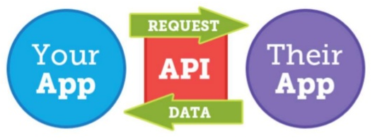
API

Slide 4
JSON-Server
JSON-Server is created for web front-end developers who need a quick back-end for prototyping and mocking.
With this package, developers can get a full fake REST API with zero coding in less than 30 seconds!
More information click: github.com/typicode/json-server

Slide 5


Create Fake REST API
with JSON-Server #1
Create a project folder, for eg lin_fake_api
Create a json file on project folder, for eg db.json
{
"karyawan":[
{"id":1,"nama":"Andi","usia":25,"kota":"Jakarta"},
{"id":2,"nama":"Budi","usia":27,"kota":"Yogya"},
{"id":3,"nama":"Caca","usia":25,"kota":"Bandung"},
{"id":4,"nama":"Dedi","usia":31,"kota":"Jakarta"},
{"id":5,"nama":"Euis","usia":22,"kota":"Bandung"}
]
}

Slide 6
Create Fake REST API
with JSON-Server #2
On project folder, type:
$ npm init
Install json-server:
$ npm install –g json-server --save
Activate json-server:
$ json-server --watch db.json
Done, see on browser
http://localhost:3000

Slide 7
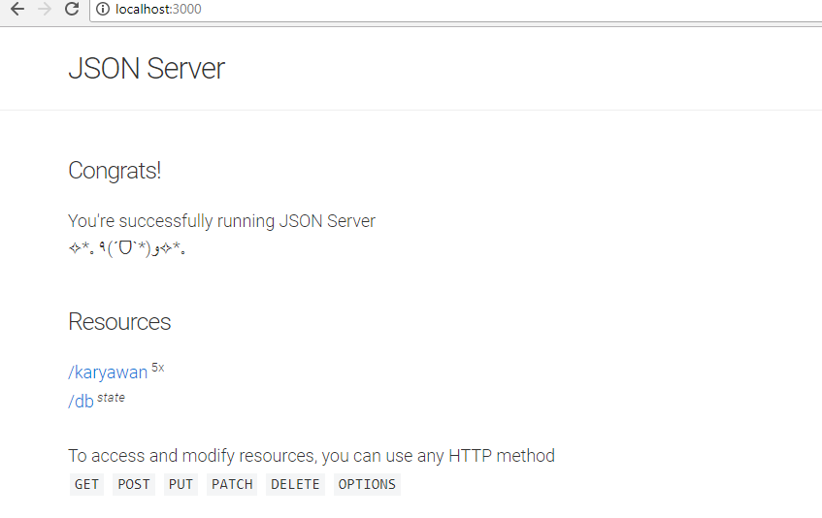
http://localhost:3000

Slide 8
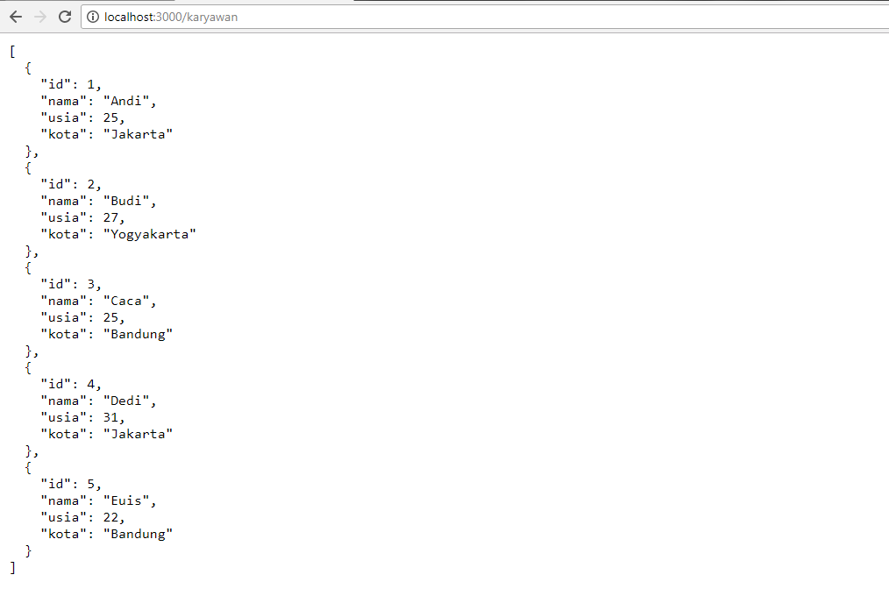
http://localhost:3000/karyawan

Slide 9
GET on Postman
localhost:3000/db
localhost:3000/karyawan
localhost:3000/karyawan/3
localhost:3000/karyawan?id=3
localhost:3000/karyawan?usia=25
localhost:3000/karyawan?_limit=3
localhost:3000/karyawan?_sort=nama&_order=desc
localhost:3000/karyawan?usia_gte=26
localhost:3000/karyawan?usia_gte=23&usia_lte=27
localhost:3000/karyawan?q=Jakarta

Slide 10
POST on Postman
Set POST to http://localhost:3000/karyawan
Set Headers Key: Content-Type & value: app/json
Insert data json on Body raw & send it, for eg:
{
"id":6,
"nama" : "Fifi",
"usia" : 28,
"kota" : "Medan"
}
Data on db.json is updated!

Slide 11
DELETE on Postman
Set DELETE to http://localhost:3000/karyawan/5 to delete data karyawan number 5.
UPDATE on Postman
Set PATCH to http://localhost:3000/karyawan/2 to update data karyawan number 2.
Set Headers Key: Content-Type & value: app/json. Insert data json on Body raw & send it, for eg:
{
"kota" : "Solo"
}

Slide 12
Try to connect
React Project to
Fake REST API!

Slide 13
JSON-Server
Create a fake REST API

